Slide 1
Estimating Phylogeny

Slide 2
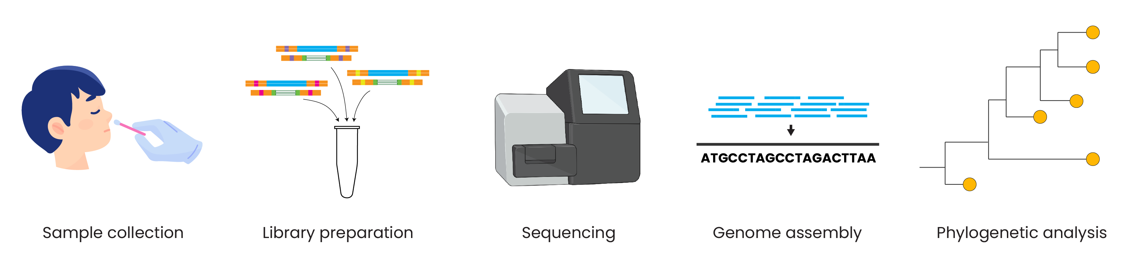
Genomic epidemiology workflow
BioRender.com
Pixel True https://www.pixeltrue.com/about, CC BY-SA 4.0, via Wikimedia Commons

Slide 3
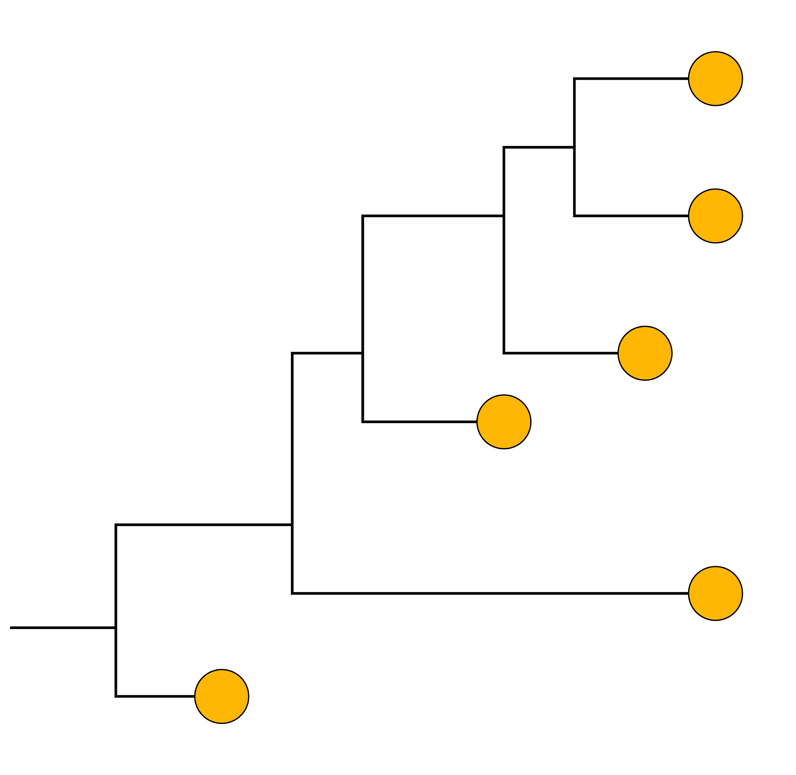
How do we build phylogenetic trees?
A
G
GTCTCGGCTC
GTGTCGGCTA
GTGTCAGCTA
GTGCCAGCTA
GGGCCATCTA
ATGCCAGCTA
C
T
Multiple sequence alignment
Substitution model
Phylogenetic tree
Bootstrapping
Collect your data (sequences)
Make assumptions about the evolutionary process
Ask which phylogeny is most likely to have given rise to the data given these assumptions
Test phylogeny and assumptions
Notes:
In other words, which tree is the most likely to give us the differences we can see between our sequences, taking into account what we know about evolution.
So you’ve got your alignment
And then we want to make assumptions about your evolutionary process (I’ll come back to this in a second), which is like how are your sequences actually evolving
Compare different phylogenies and ask is the data likely to have come from this?
Test them – see support, do model selection (won’t go into latter, but will into former)

Slide 4
Outline
Tree search algorithm
Maximum likelihood
How to build trees with IQTREE
Input data
Model selection
Bootstrapping

Slide 5
how to find the right tree?
Tree inference software test different tree topology
based on alignment and pick the best according to certain criterion.

Slide 6
Possible trees
A
A
C
B
C
B
C
B
A
3 taxa = 3 possible trees

Slide 7
A
A
C
B
B
C
A
C
B
D
D
D
A
D
A
B
B
D
C
C
C
D
A
B
And so on…..4 taxa = 15 possible trees

Slide 8
The problem
Rapidly gets too big
(2n – 3)!! Possible trees where n is the number of sequences
So this means:
5 sequences = 105 trees
10 sequences = 34459425 trees
48 sequences = 3.21 x 10^70 trees
1888 sequences = 1.15 x 10^5930 possible trees
Notes:
So if there are 5 sequences, we do 2x5 – 3 = 7, and then we do 7x5x3x1 and that’s how many trees we get. Properly explain double factorial
The Ebola dataset from west Africa currently has 1888 sequences in it
So we can’t possibly check all of these trees, we need a way to search the so called tree space

Slide 9
There are several methods of building trees
Distance-based neighbor-joining
Parsimony
Maximum likelihood
Bayesian

Slide 10
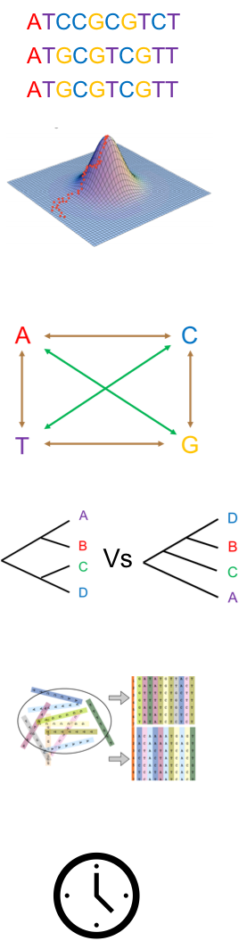
how to find the right tree?
We do have algorithms that make a single tree
The most common of these is the Neighbour Joining algorithm:
Ask which two sequences are most similar
Join them together, treat as one sequence
Ask which sequence is next most similar, join that one as well
This is fast and works fine, but only gives you the option of one tree
Doesn’t always give you the best tree, but you have no way of knowing
Need a method that actually explores different options to find the best tree
Notes:
If you only get one tree, it might be right but you have no way of knowing. You need to explore lots of options so that you can be sure that you’ve chosen the right tree. No measure of support here, so you have no way of knowing how good the tree is.
So we need methods that explore different trees and find which one is actually most likely to give rise to the data

Slide 11
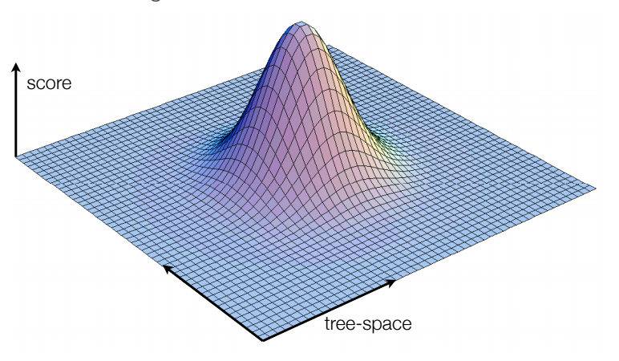
Slide adapted from Andrew Rambaut
Notes:
Imagine that each of the possible trees exists in a 3D space, and to find the right tree you have to explore this space.
You want one with a good score (ie likely to give the data – we’ll discuss what that means in a second). So the best tree is on top of that hill – how do we get there?

Slide 12
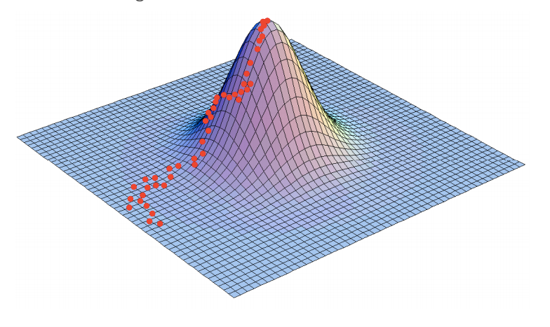
Slide adapted from Andrew Rambaut
Notes:
We climb it!
Each red dot is a sampled tree. We look at the score of the tree and look at the score of the next one. If it’s got a better score we move there (ie up the hill) and then look at the next one. If it has a worse score we stay on the tree we’re on.
In this way we climb the hill to the tree with the highest score. Once we are on the top of the tree, all of the trees around will have a lower score
How do we know what the score of a tree is?
First have to make some assumptions about the underlying evolutionary processes

Slide 13
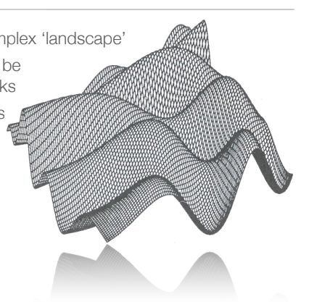
Slide adapted from Andrew Rambaut
Notes:
But in reality landscapes look like this – it’s quite easy to get stuck in a local optimum.
At any rate we’re still trying to find the highest peak, so how do we do this?
First have to make some assumptions about the underlying evolutionary processes
[NB: ML gives one tree. We try and find the highest thing but we can’t always. Not sure you can use ML with MCMC.
But, MCMC is structured random sampling, and is used in conjunction w Bayesian methods, which give you a group of trees it thinks is most likely using a related but different optimization method. ]

Slide 14
There are several methods of building trees
Distance-based neighbor-joining
Parsimony
Maximum likelihood
Bayesian

Slide 15
Building a Maximum Likelihood Tree

Slide 16
Building maximum likelihood trees
Maximum Likelihood (ML): a statistical framework that allows us to assess which hypothesis (tree) best explains our data (the sequences)
The degree to which the data or alignment supports a hypothesis or tree is termed the likelihood.
ML is a very statistically robust method to model sequence evolution and generate a single tree or phylogeny
Notes:
So now we know how to find the best tree, and what the evolution looks like that we can’t see, we have to work out how to score the trees so we know how to climb the hill. Basically what we’ve been talking about the whole way through!
ML is good, and you will often see it in published papers
Some of the applications we’ll talk about later require these more complicated trees, but for a lot of purposes, an ML tree will do you just fine.
[ML is data given model. Bayesian is model given data]

Slide 17
Find the tree that makes the data most probable
Probability?
A
G
GTCTCGGCTC
GTGTCGGCTA
GTGTCAGCTA
GTGCCAGCTA
GGGCCATCTA
ATGCCAGCTA
+
C
T
Or would a different tree explain the sequence alignment better?

Slide 18
Software to infer phylogenies by maximum likelihood
Pros and cons to each software
Several options have web servers for easy-to-use, online computation
IQ-TREE
RAxML
PhyML
Garli
FastTree
iqtree -asr -s ./Desktop/CAM_NIG_Zoonoses1.fasta -czb -m JC
http://tree.bio.ed.ac.uk/software/figtree/

Slide 19

IQ-TREE: web server: http://iqtree.cibiv.univie.ac.at/

Slide 20
Step 1: Input data
IQ-TREE: web server: http://iqtree.cibiv.univie.ac.at/

Slide 21
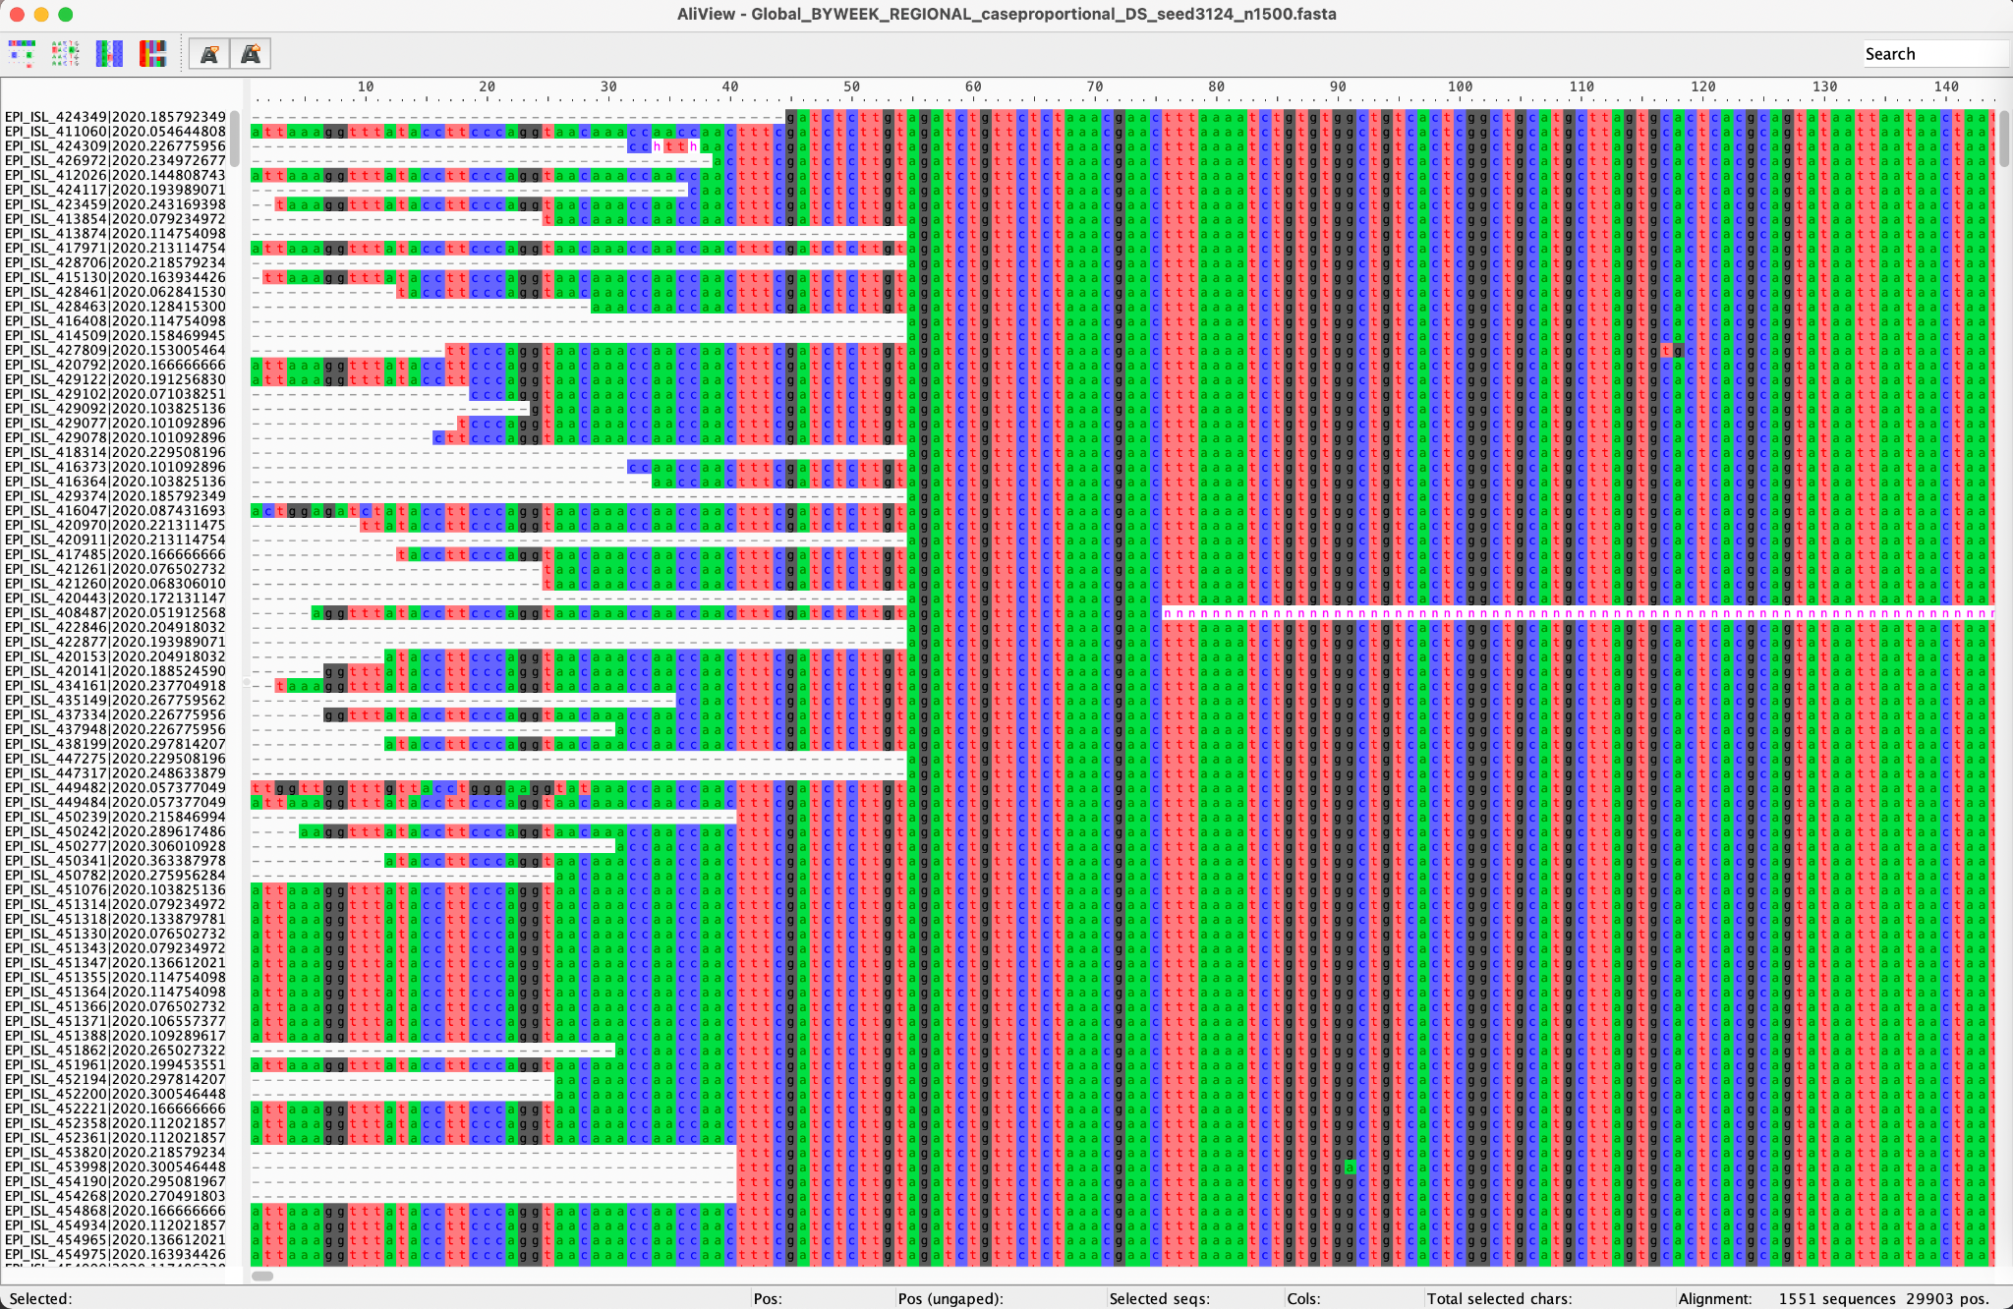
IQ-TREE input: multiple sequence alignment

Slide 22

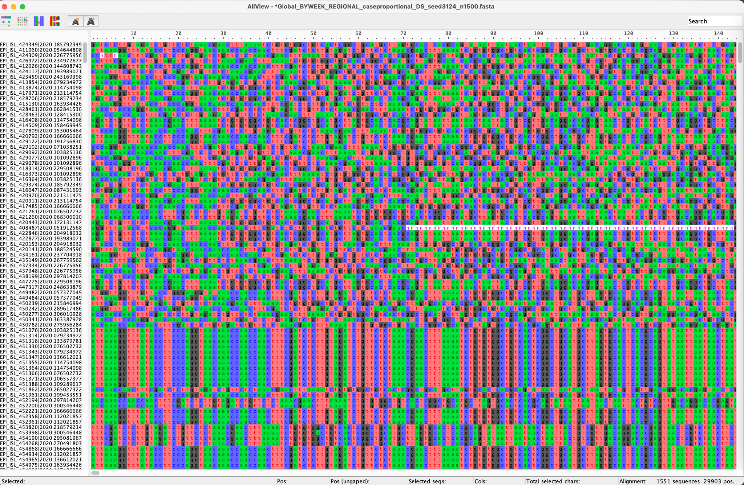
Sequences must be aligned
Don’t use unaligned sequences

Slide 23
Step 2: Substitution model selection
IQ-TREE: web server: http://iqtree.cibiv.univie.ac.at/

Slide 24
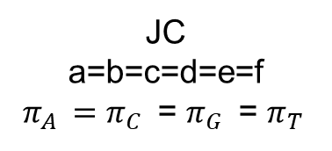
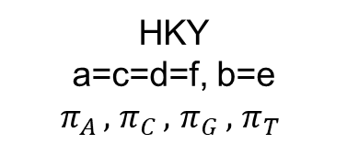
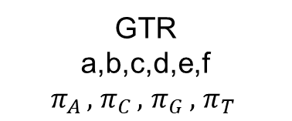
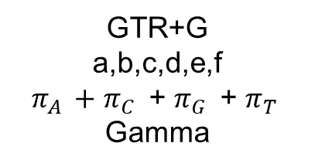
There are several options for substitution models
Substitution rate matrix
b
A
G
c
a
f
d
C
T
e

Slide 25

IQ-TREE: web server: http://iqtree.cibiv.univie.ac.at/

Slide 26

IQ-TREE: web server: http://iqtree.cibiv.univie.ac.at/

Slide 27
Allowing for rate heterogeneity
Substitution rate matrix
Different sites may evolve at different rates:
b
G | A | C | T | C | G | G | C | T | C
G | T | G | T | C | G | G | C | T | A
G | C | G | T | C | A | G | C | T | A
G | G | G | C | C | A | G | C | T | A
G | G | G | C | C | A | G | C | T | A
A | T | G | C | C | A | G | C | T | A
A
G
c
a
f
d
C
T
e

Slide 28
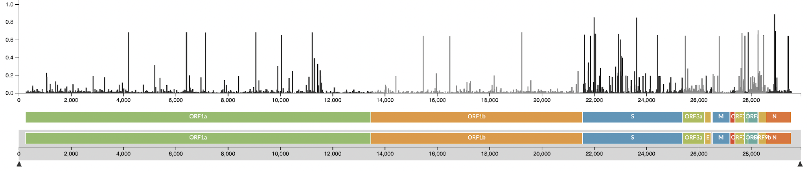
Allowing for rate heterogeneity
Different selection processes acts on different sites
Site 1 evolves fast
G | A | C | T | C | G | G | C | T | C
G | T | G | T | C | G | G | C | T | A
G | C | G | T | C | A | G | C | T | A
G | G | G | C | C | A | G | C | T | A
G | G | G | C | C | A | G | C | T | A
A | T | G | C | C | A | G | C | T | A
https://nextstrain.org/ncov/gisaid/global

Slide 29
Allowing for rate heterogeneity
Different selection processes acts on different sites
Site 5 evolves slowly
G | A | C | T | C | G | G | C | T | C
G | T | G | T | C | G | G | C | T | A
G | C | G | T | C | A | G | C | T | A
G | G | G | C | C | A | G | C | T | A
G | G | G | C | C | A | G | C | T | A
A | T | G | C | C | A | G | C | T | A
https://nextstrain.org/ncov/gisaid/global

Slide 30
IQ-TREE: web server: http://iqtree.cibiv.univie.ac.at/

Slide 31
Step 3:
Branch support (bootstrapping)
IQ-TREE: web server: http://iqtree.cibiv.univie.ac.at/

Slide 32
Calculating tree support: bootstrapping
Now that we have a tree which we believe to be optimal, we must check how well supported it is by the observed data.
To do this we use a statistical technique called bootstrapping:
Resample your sequence data – mix up the order of your alignment columns
Construct a tree for each resample
See what branching patterns you get and how many times you get them

Slide 33
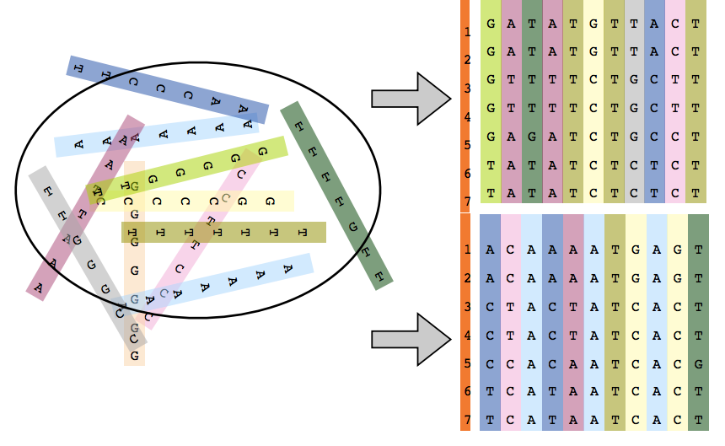
Slide adapted from Andrew Rambaut
Notes:
So this is what I mean by resampling

Slide 34
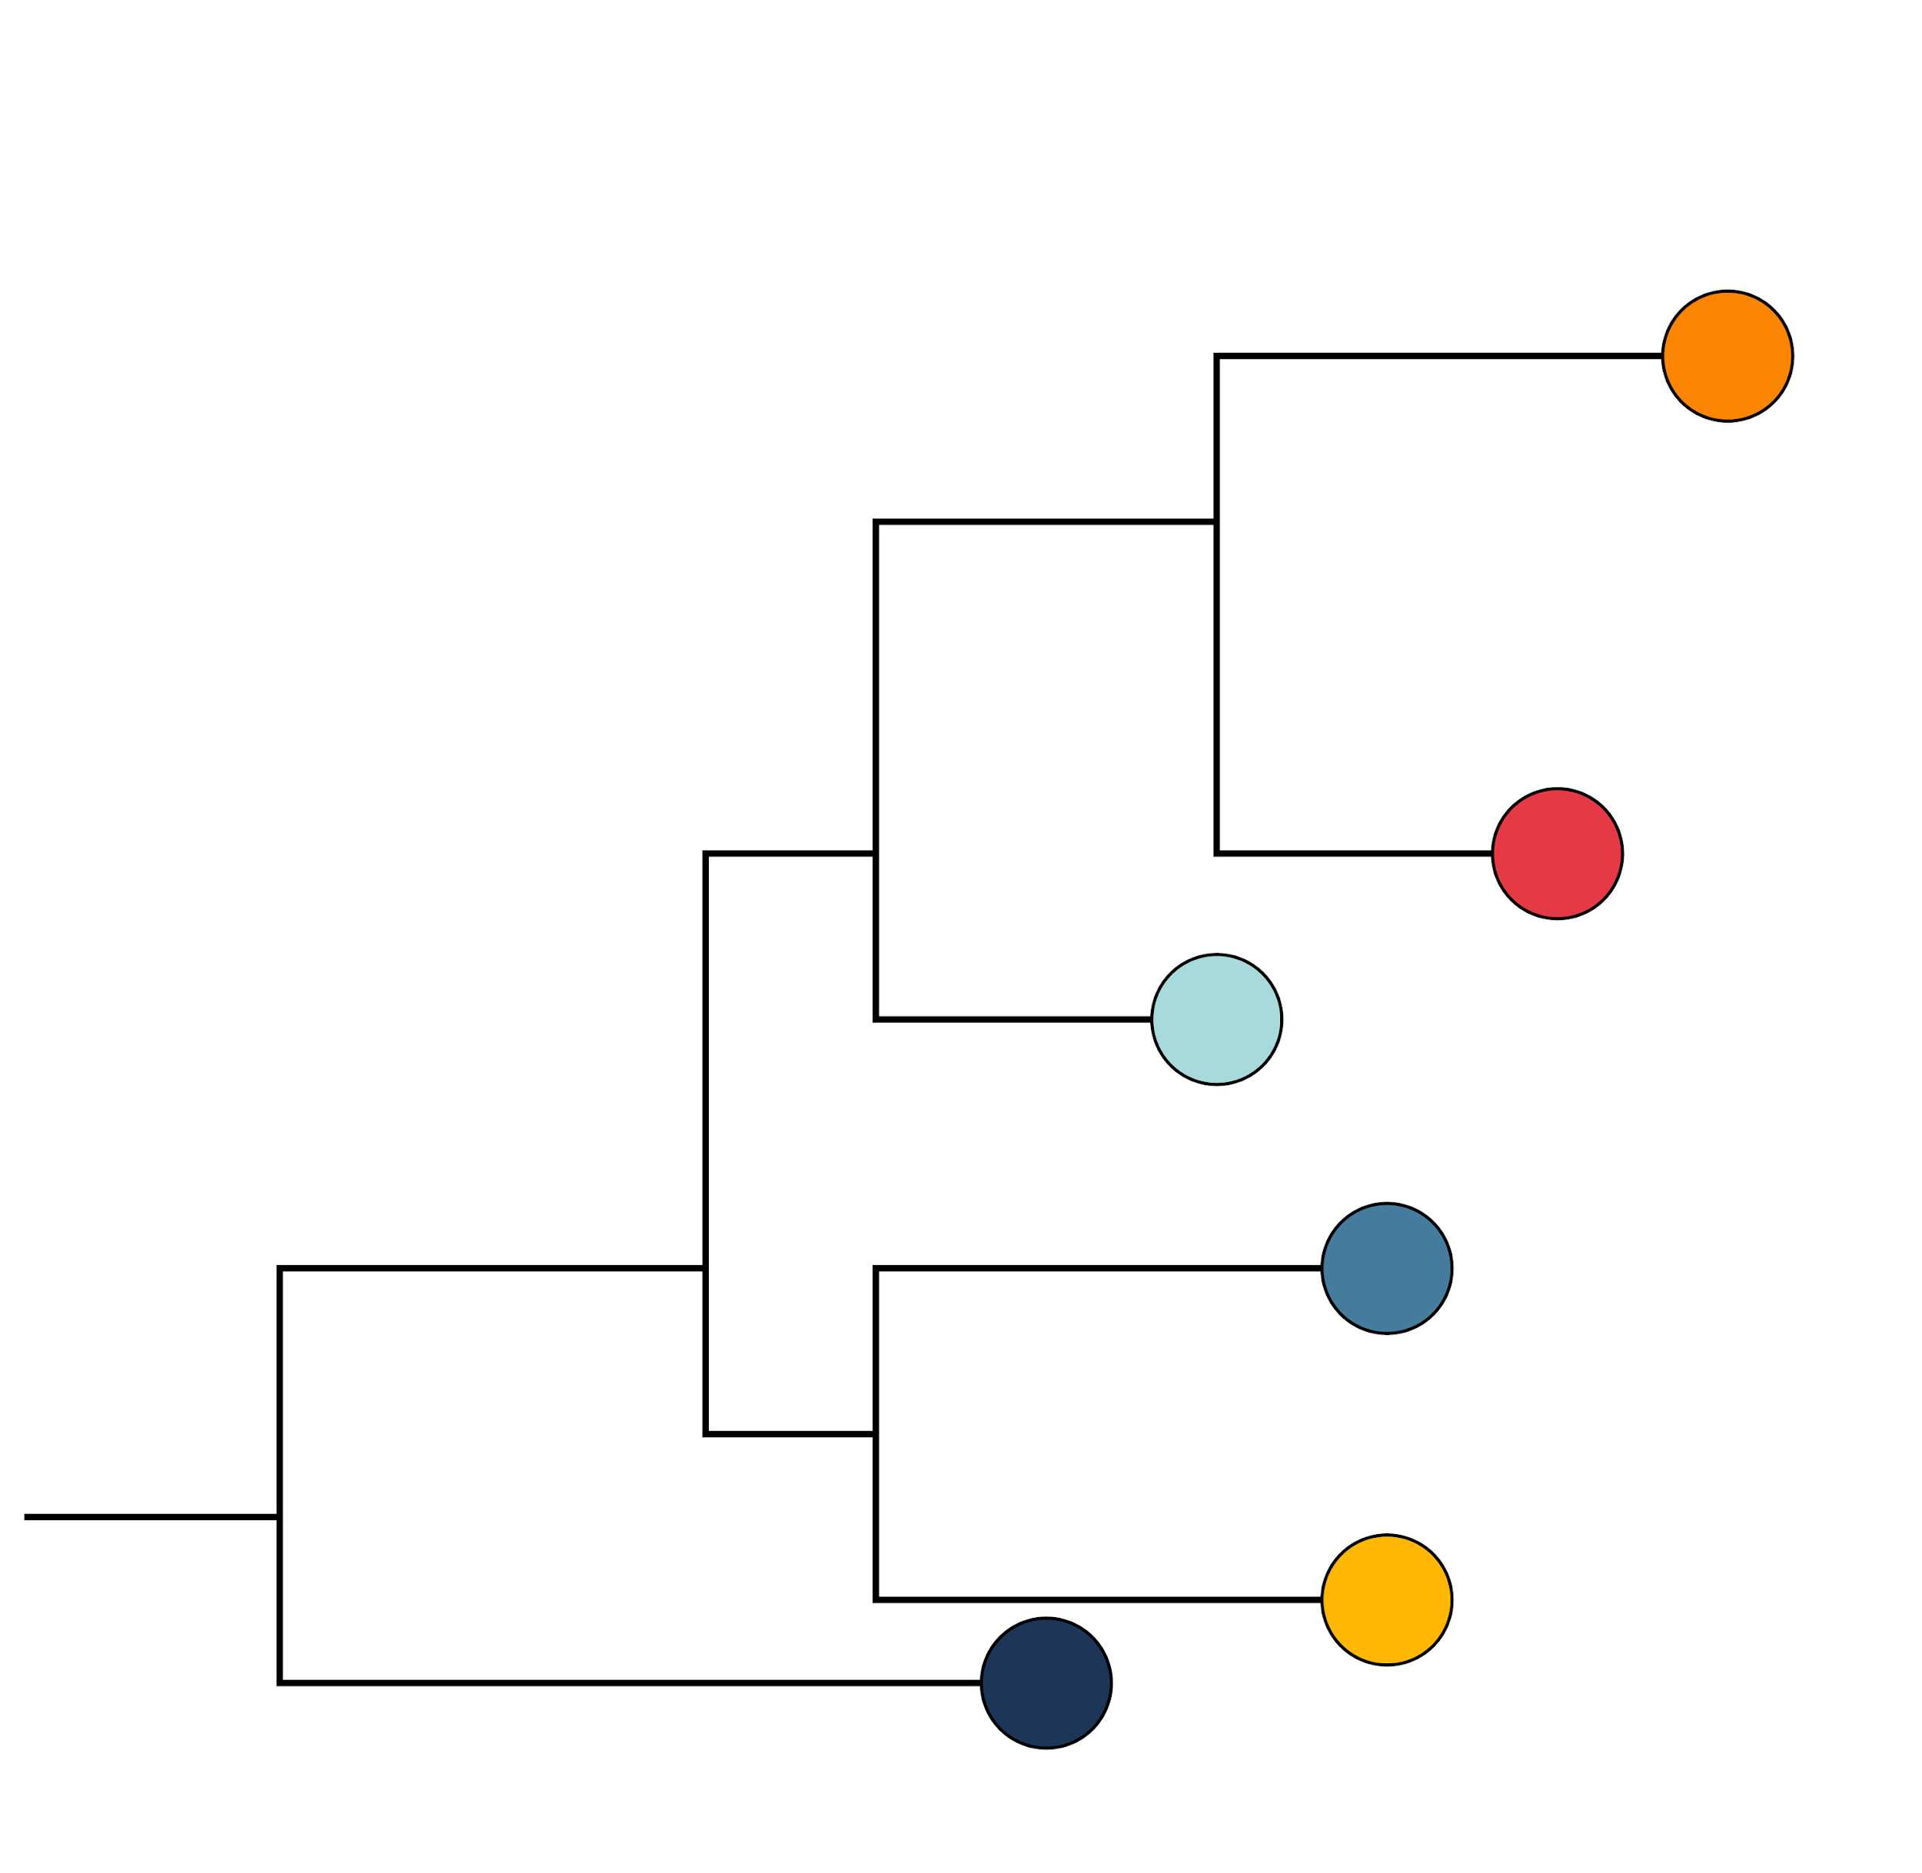
How much can we trust the tree?
Would we still get the same tree if the data was slightly different?
Tree based on original alignment
G | T | C | T | C | G | G | C | T | C
G | T | G | T | C | G | G | C | T | A
G | T | G | T | C | A | G | C | T | A
G | T | G | C | C | A | G | C | T | A
G | G | G | C | C | A | G | C | T | A
A | T | G | C | C | A | G | C | T | A

Slide 35
How much can we trust the tree?
Would we still get the same tree if the data was slightly different?
Tree based on original alignment
Resample alignment 1000 times
G | T | C | T | C | G | G | C | T | C
G | T | G | T | C | G | G | C | T | A
G | T | G | T | C | A | G | C | T | A
G | T | G | C | C | A | G | C | T | A
G | G | G | C | C | A | G | C | T | A
A | T | G | C | C | A | G | C | T | A
G | C | C | G | G | C | T
G | C | G | G | G | A | T
G | C | G | A | G | A | T
G | C | G | A | G | A | T
G | C | G | A | G | A | G
A | C | G | A | A | A | T
1000x

Slide 36
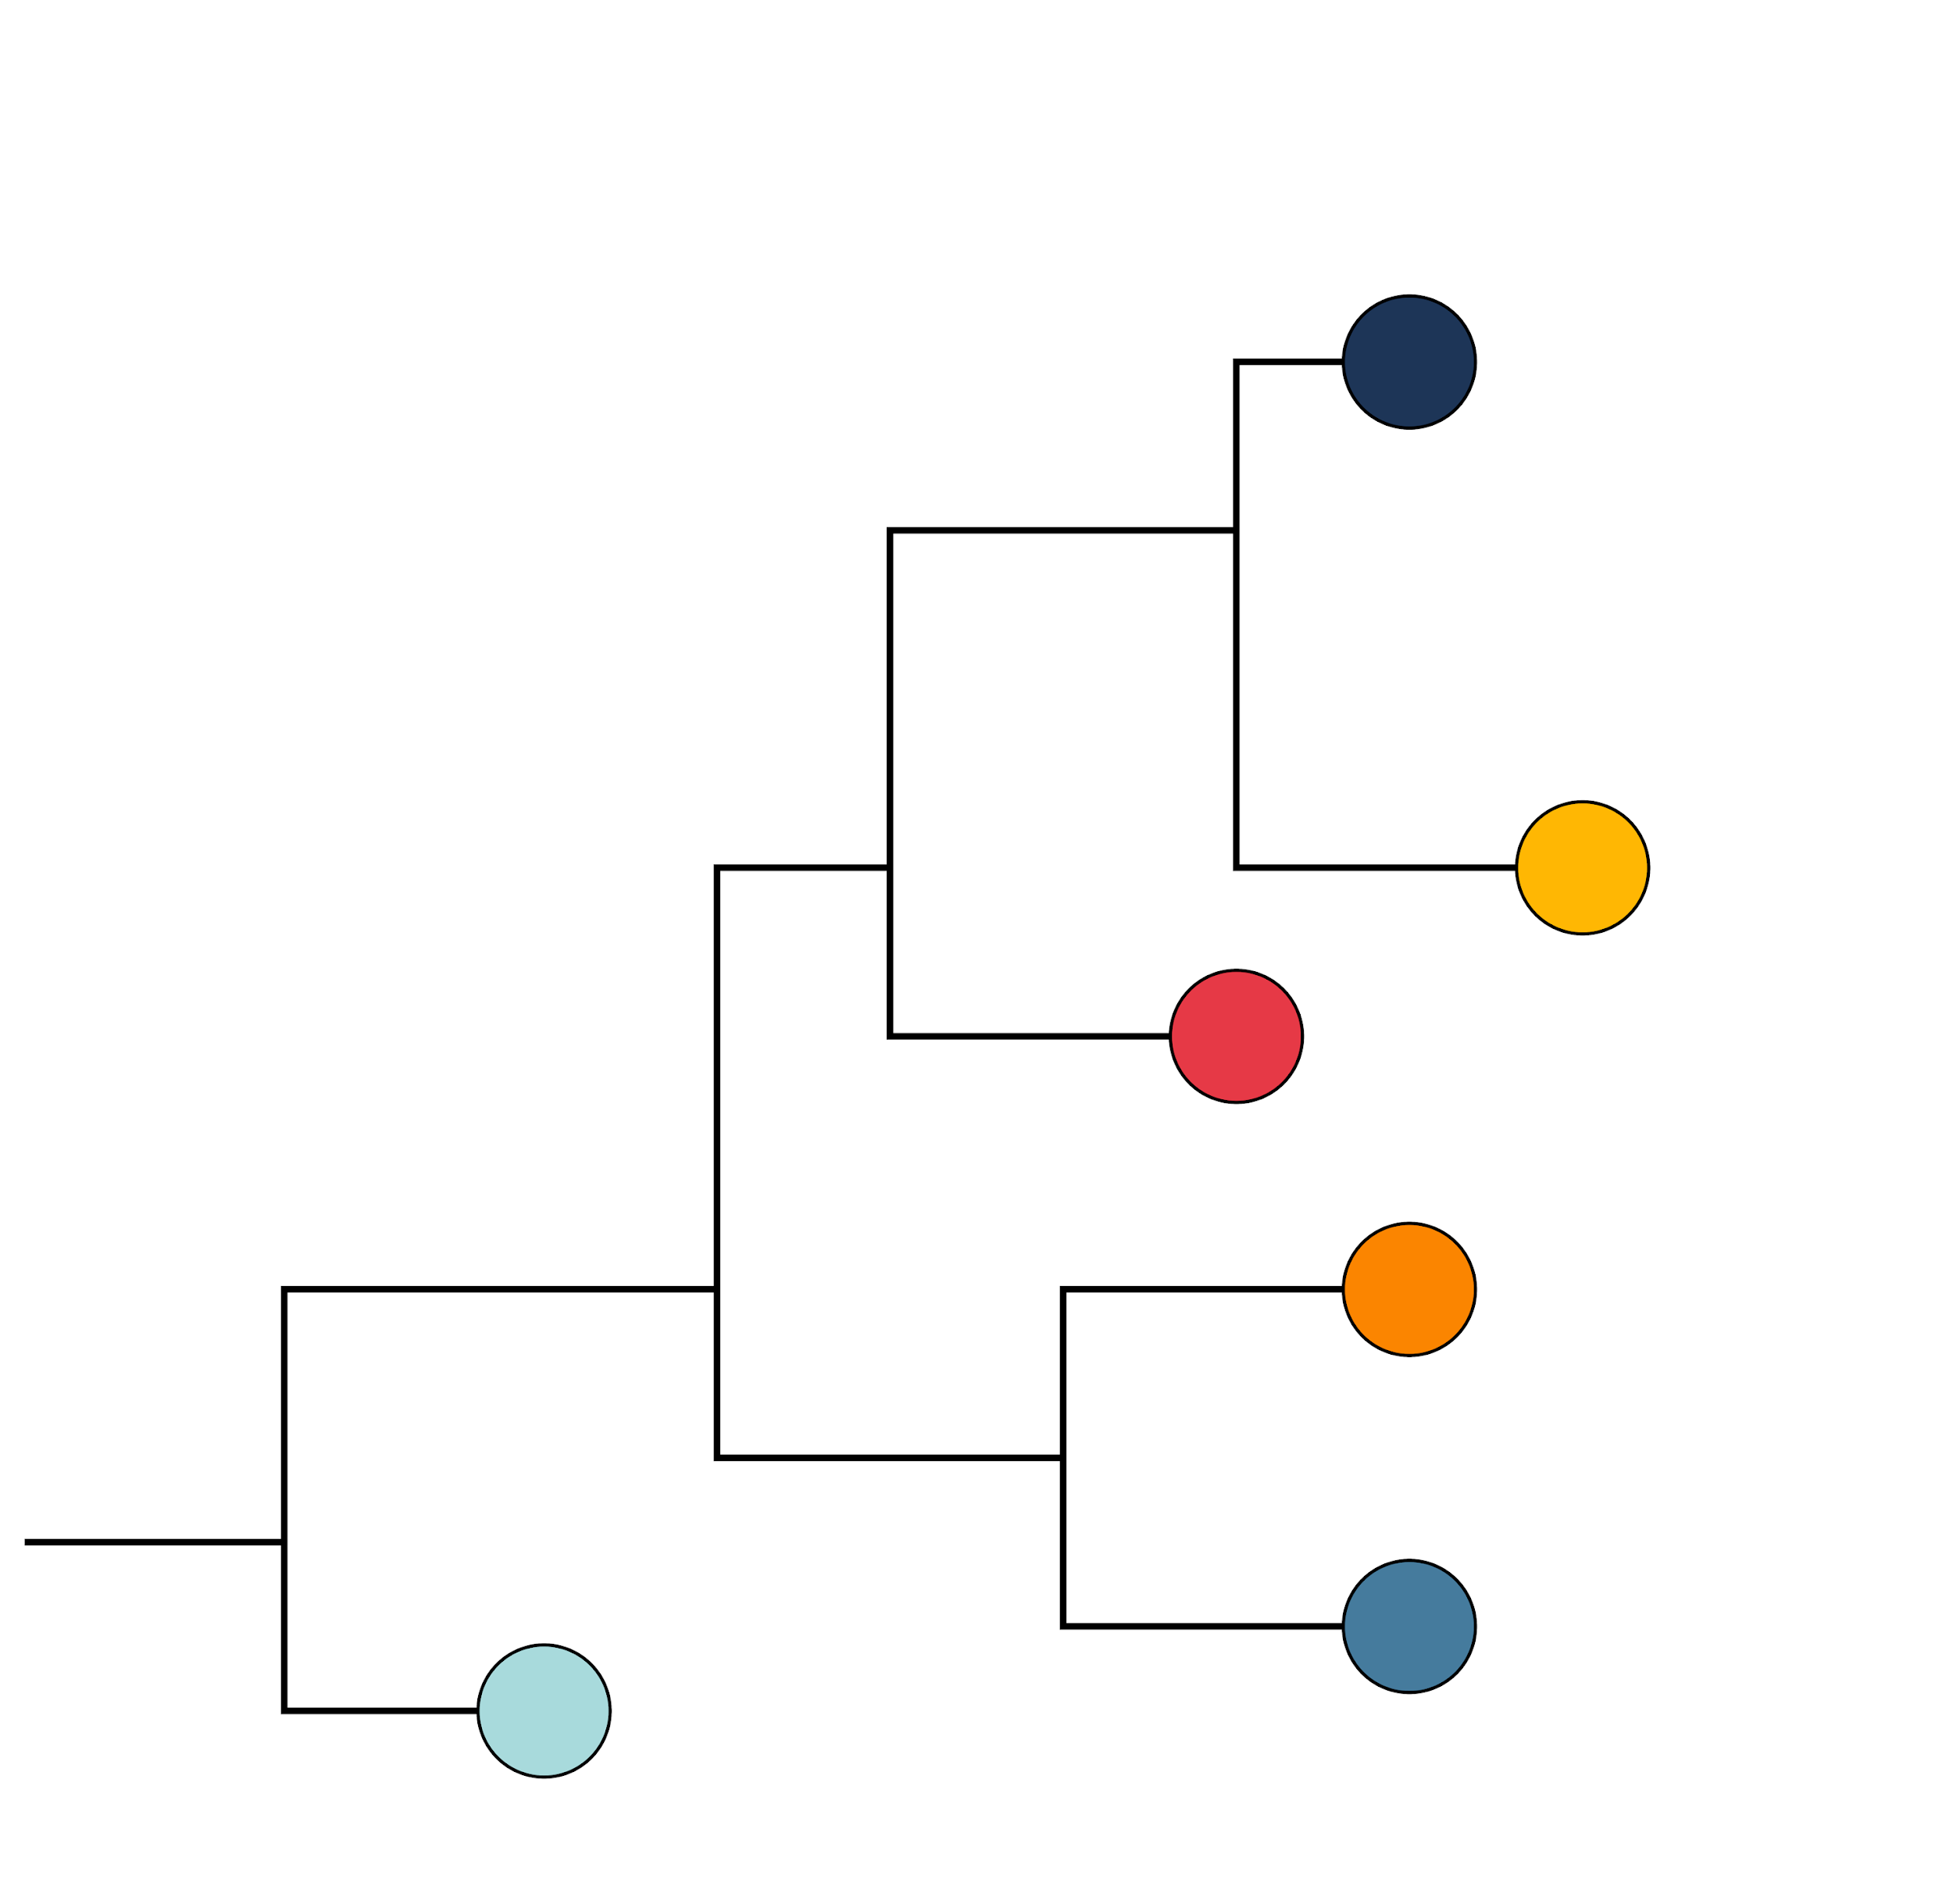
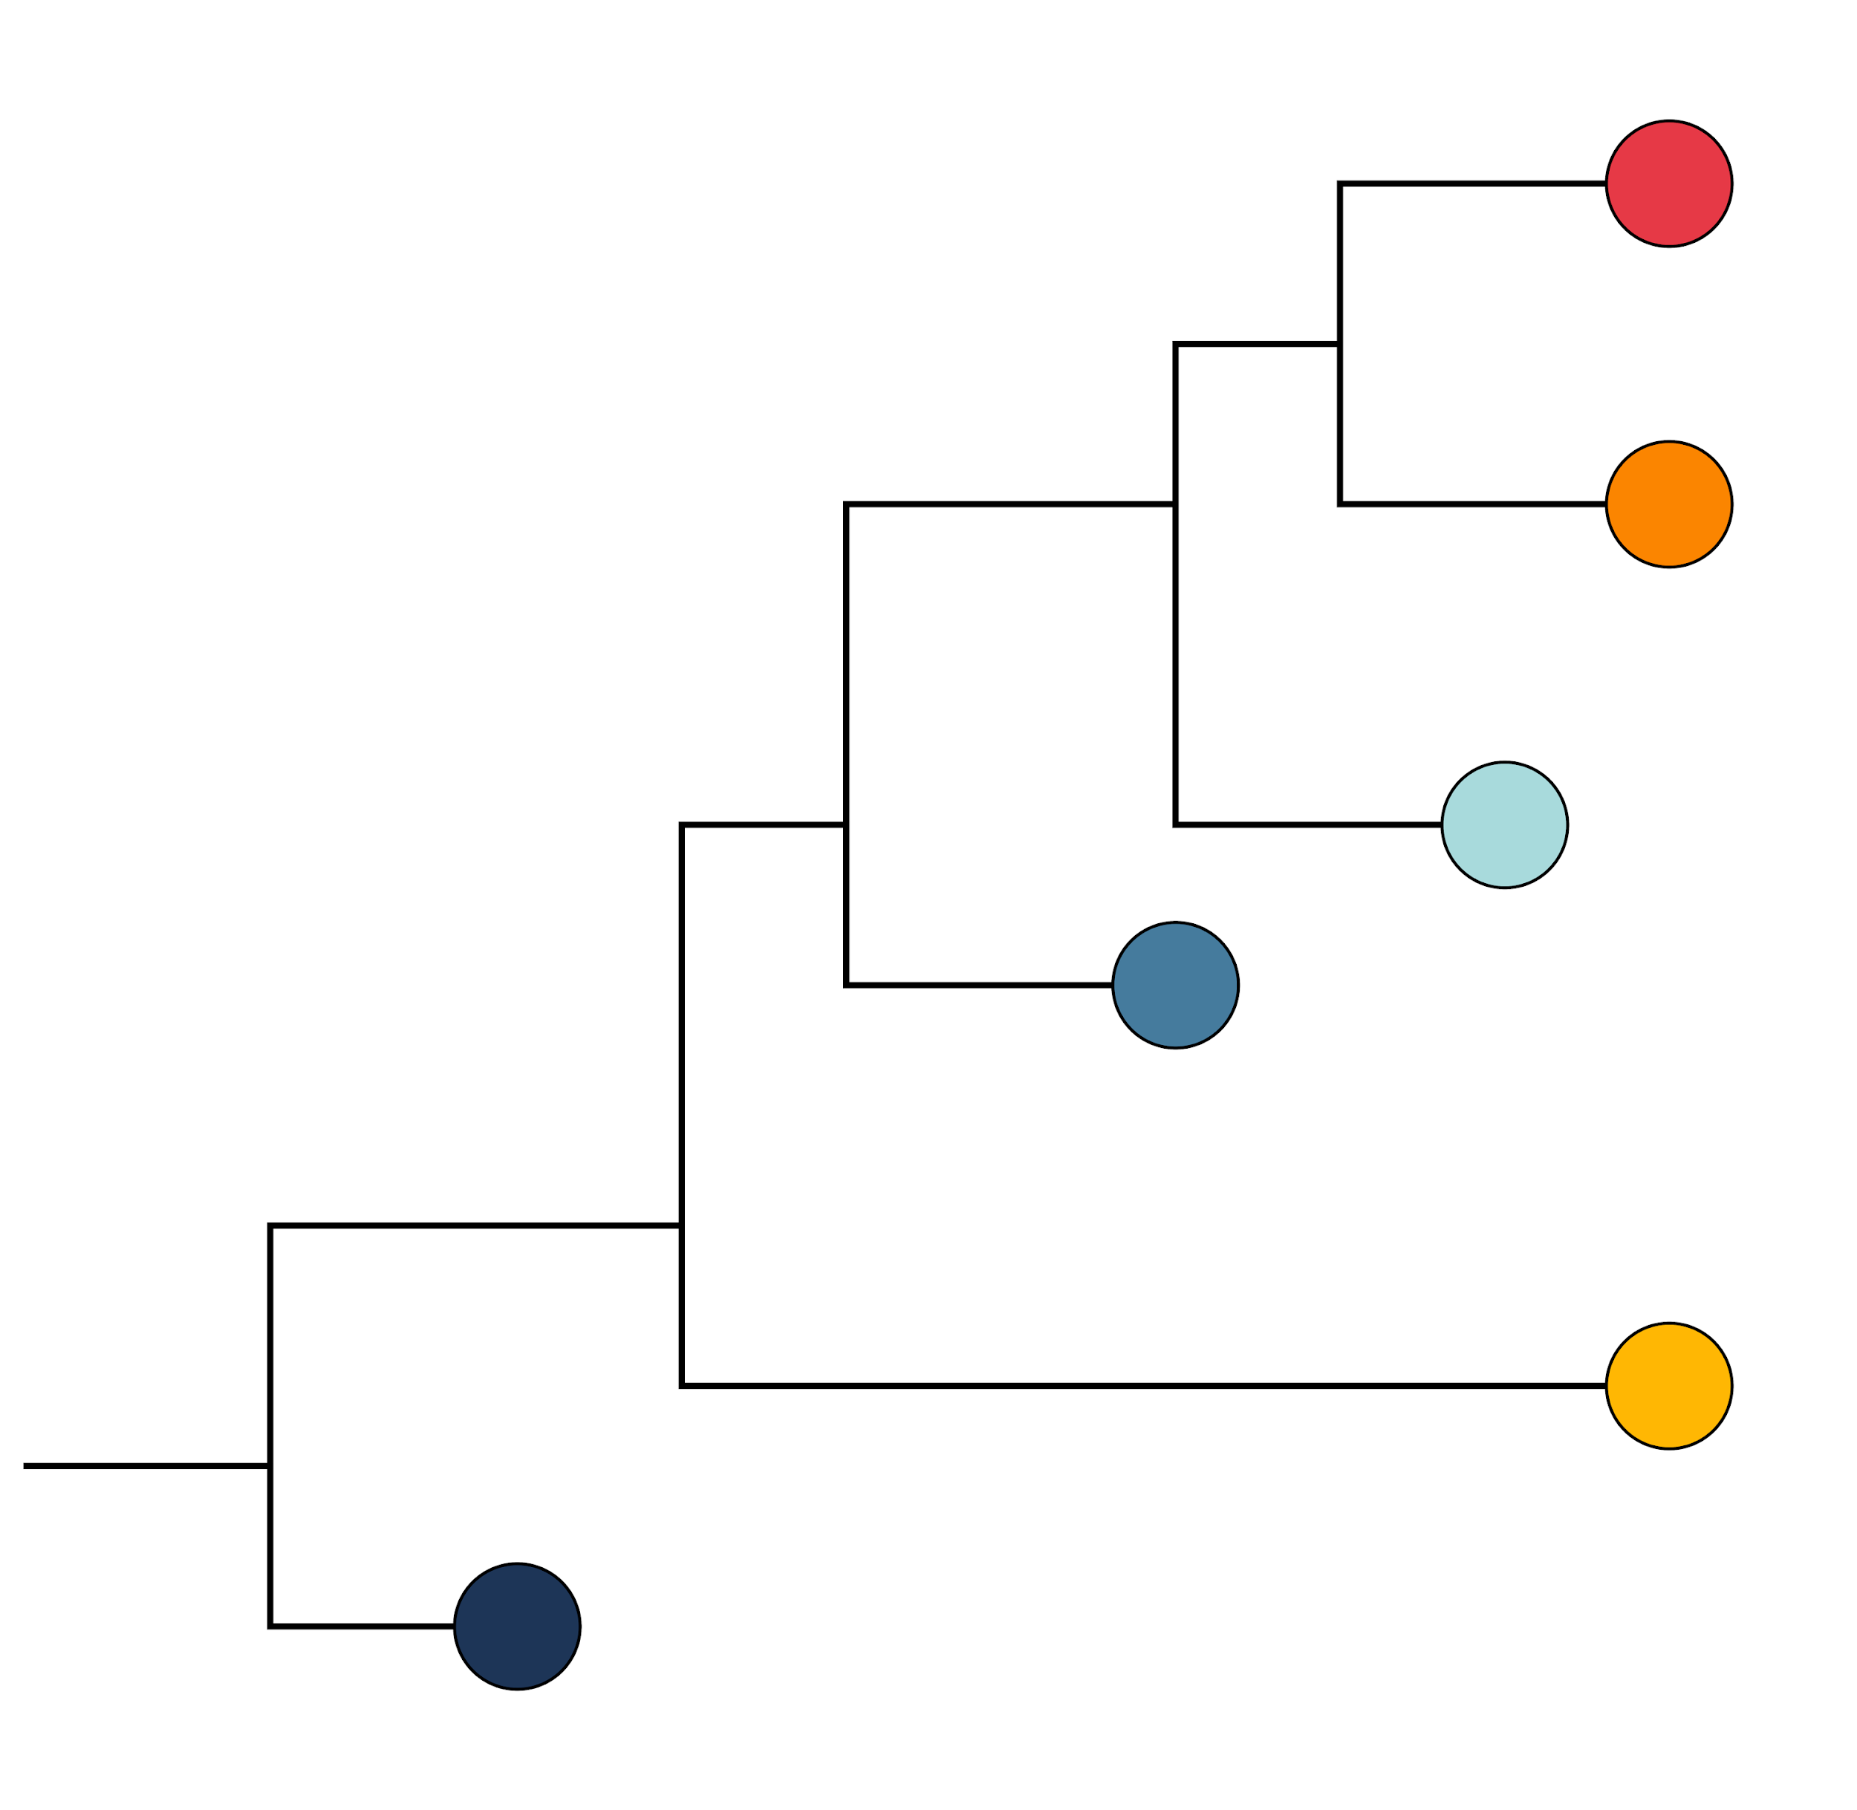
How much can we trust the tree?
Would we still get the same tree if the data was slightly different?
Tree based on original alignment
Resample alignment 1000 times
Build a tree for each resampled alignment
G | T | C | T | C | G | G | C | T | C
G | T | G | T | C | G | G | C | T | A
G | T | G | T | C | A | G | C | T | A
G | T | G | C | C | A | G | C | T | A
G | G | G | C | C | A | G | C | T | A
A | T | G | C | C | A | G | C | T | A
G | C | C | G | G | C | T
G | C | G | G | G | A | T
G | C | G | A | G | A | T
G | C | G | A | G | A | T
G | C | G | A | G | A | G
A | C | G | A | A | A | T
1000x
1000x
How many times do we see the same relationships?

Slide 37

Step 4:
Run IQ-TREE
IQ-TREE: web server: http://iqtree.cibiv.univie.ac.at/

Slide 38
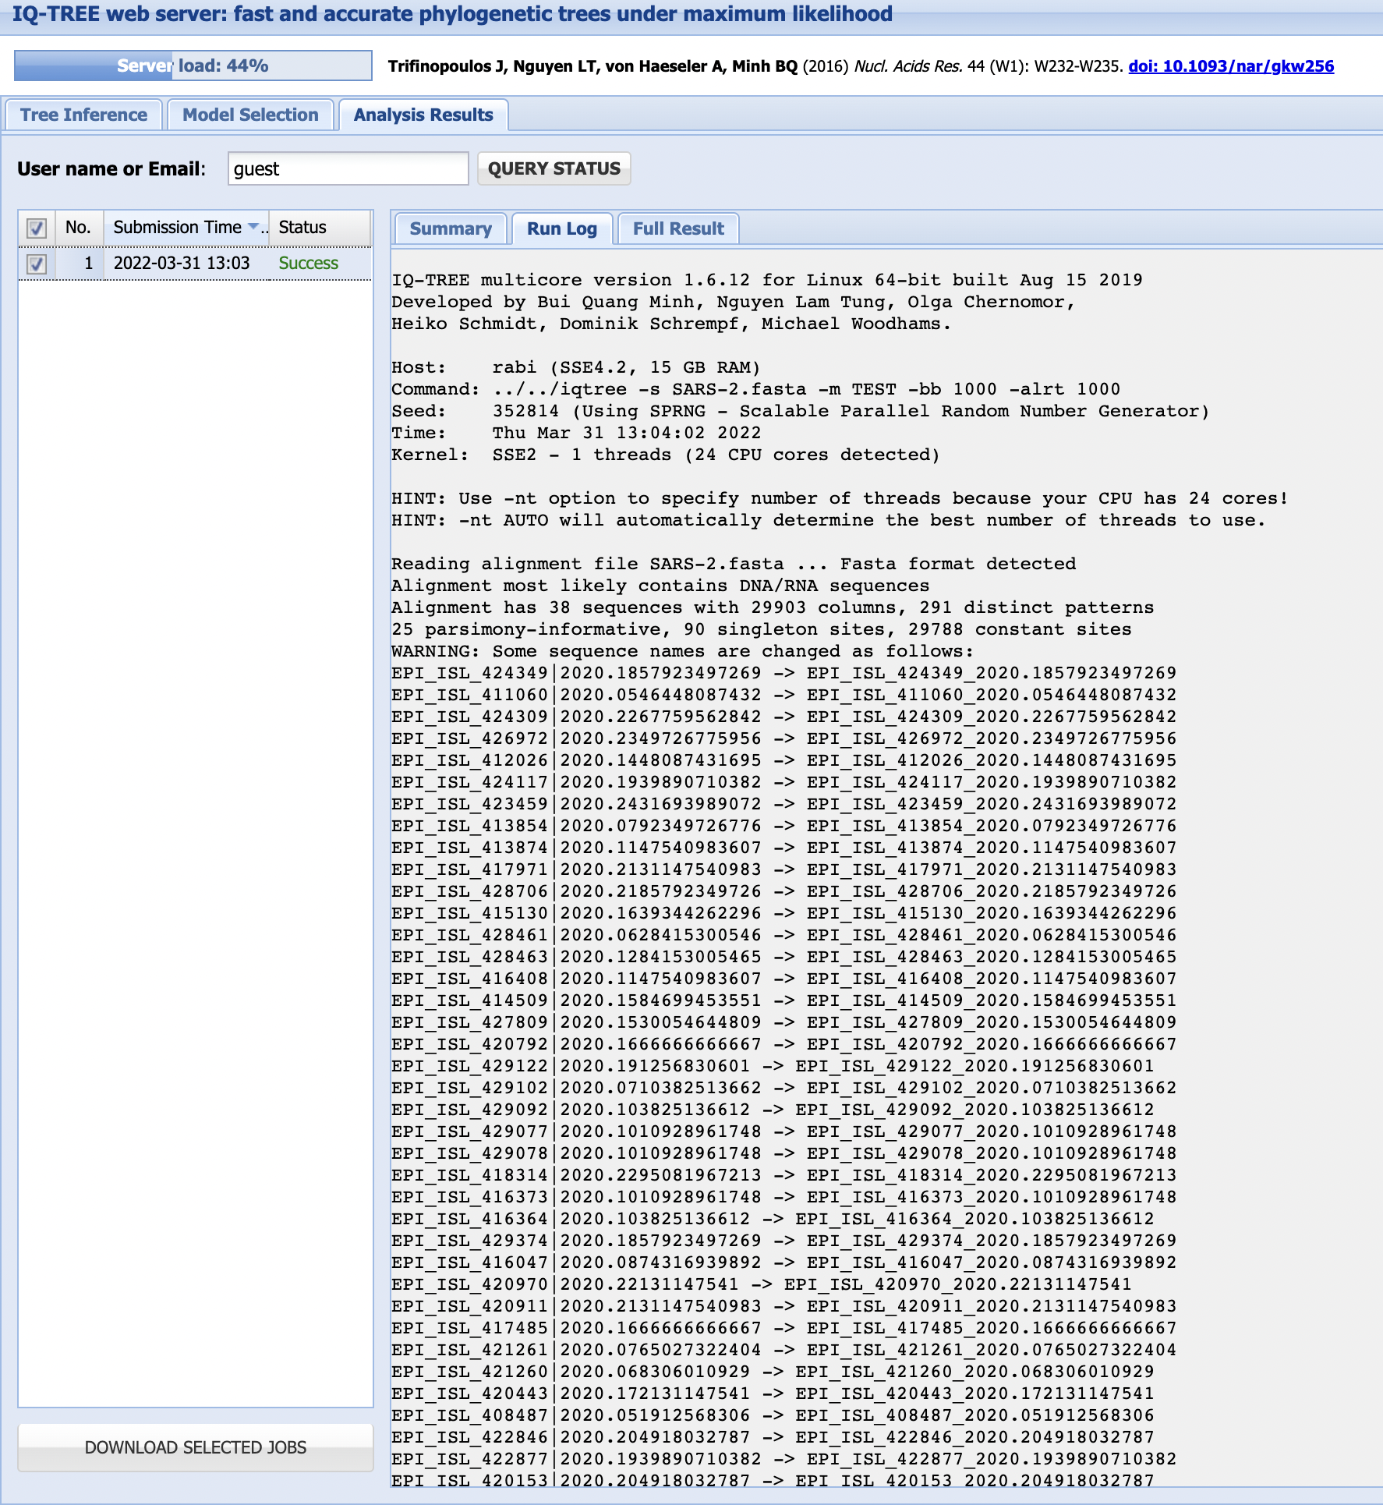

Slide 39
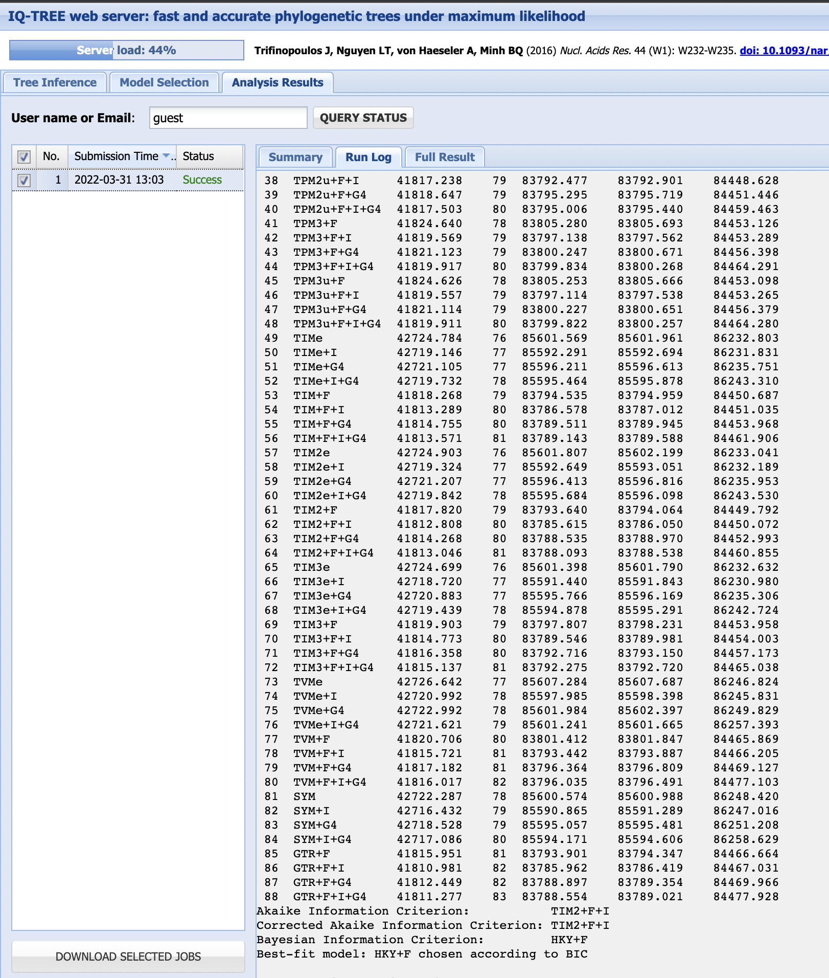
Testing different substitution models

Slide 40
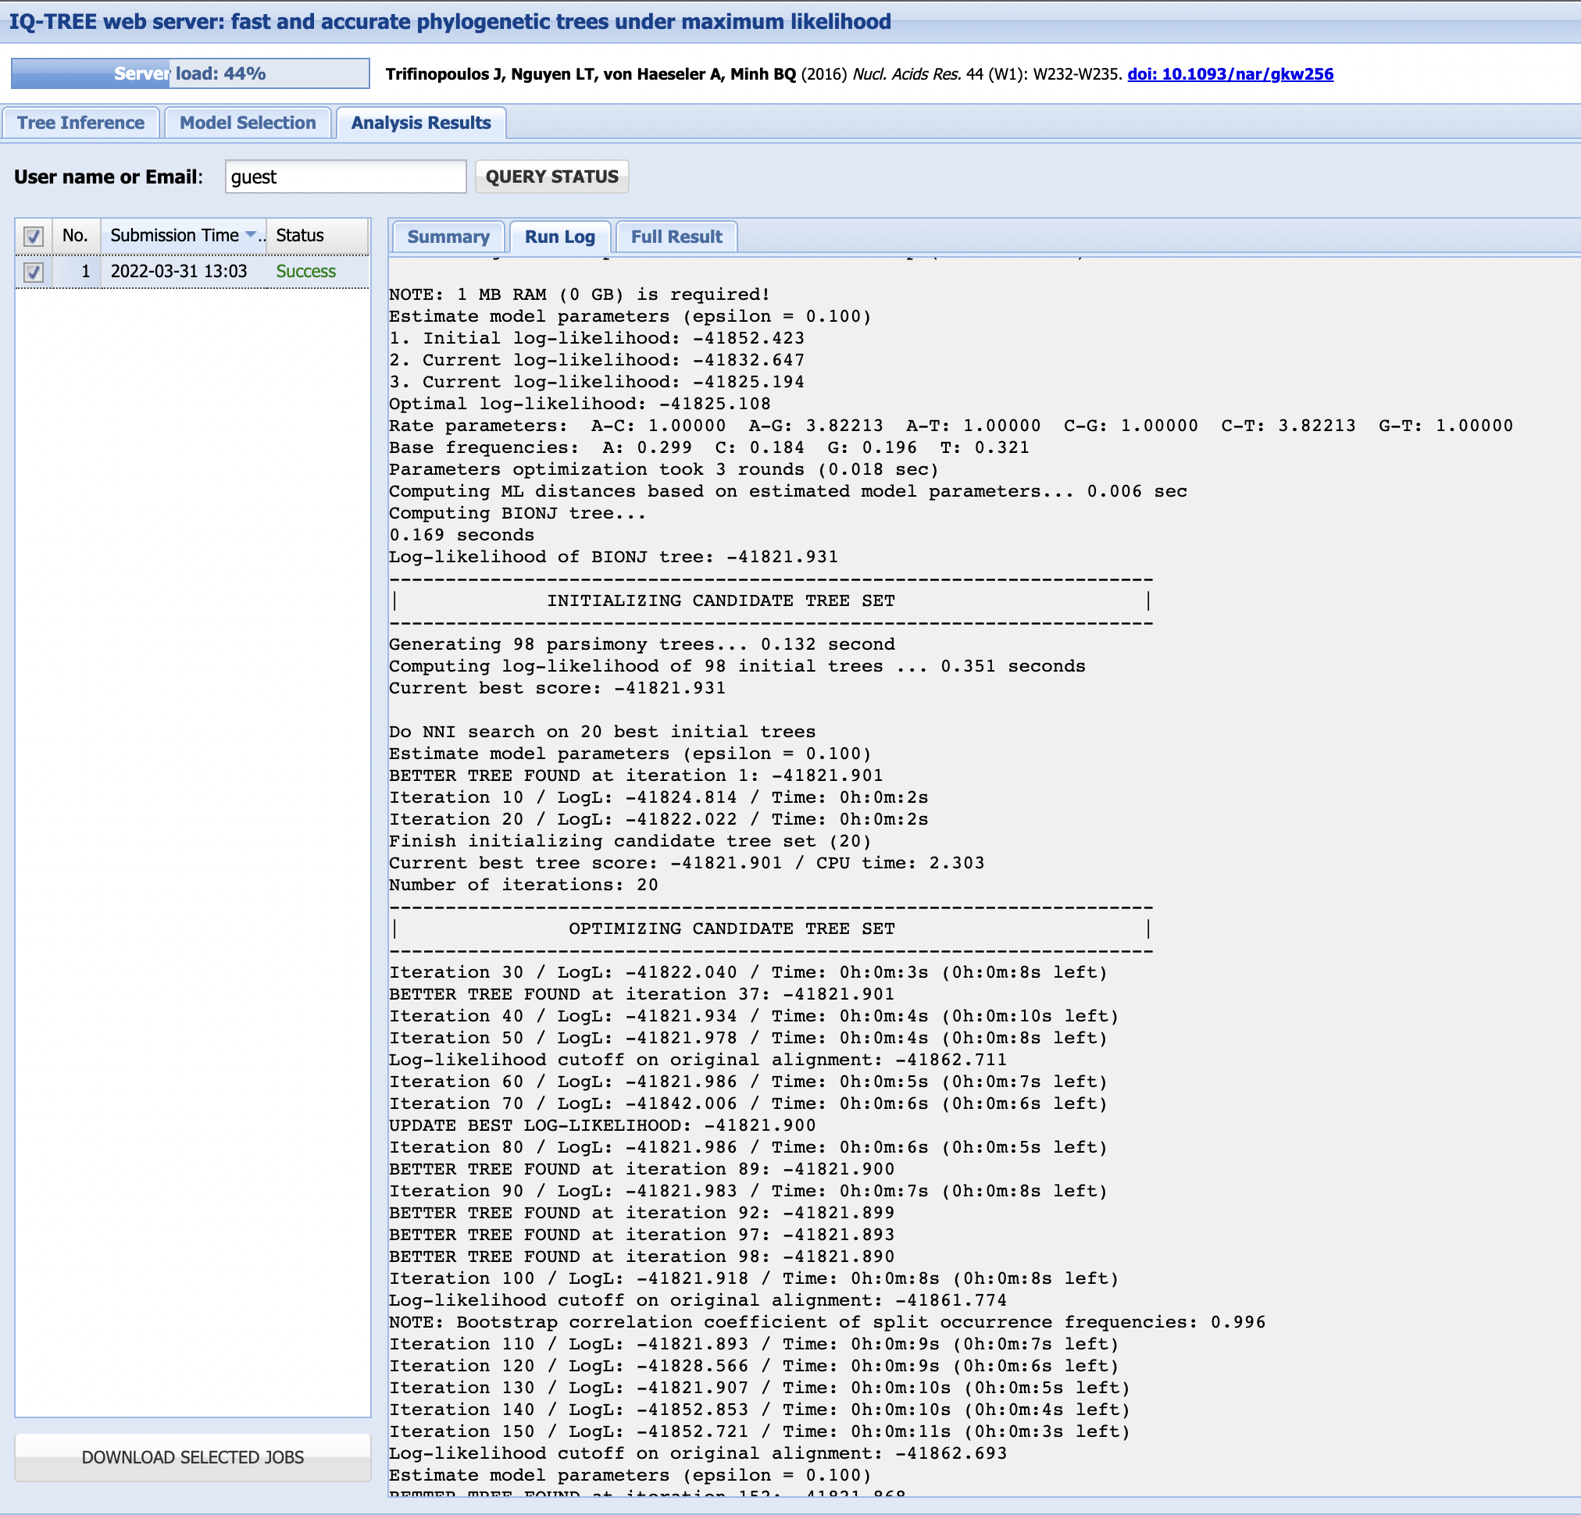
How does the maximum likelihood approach work?

Slide 41
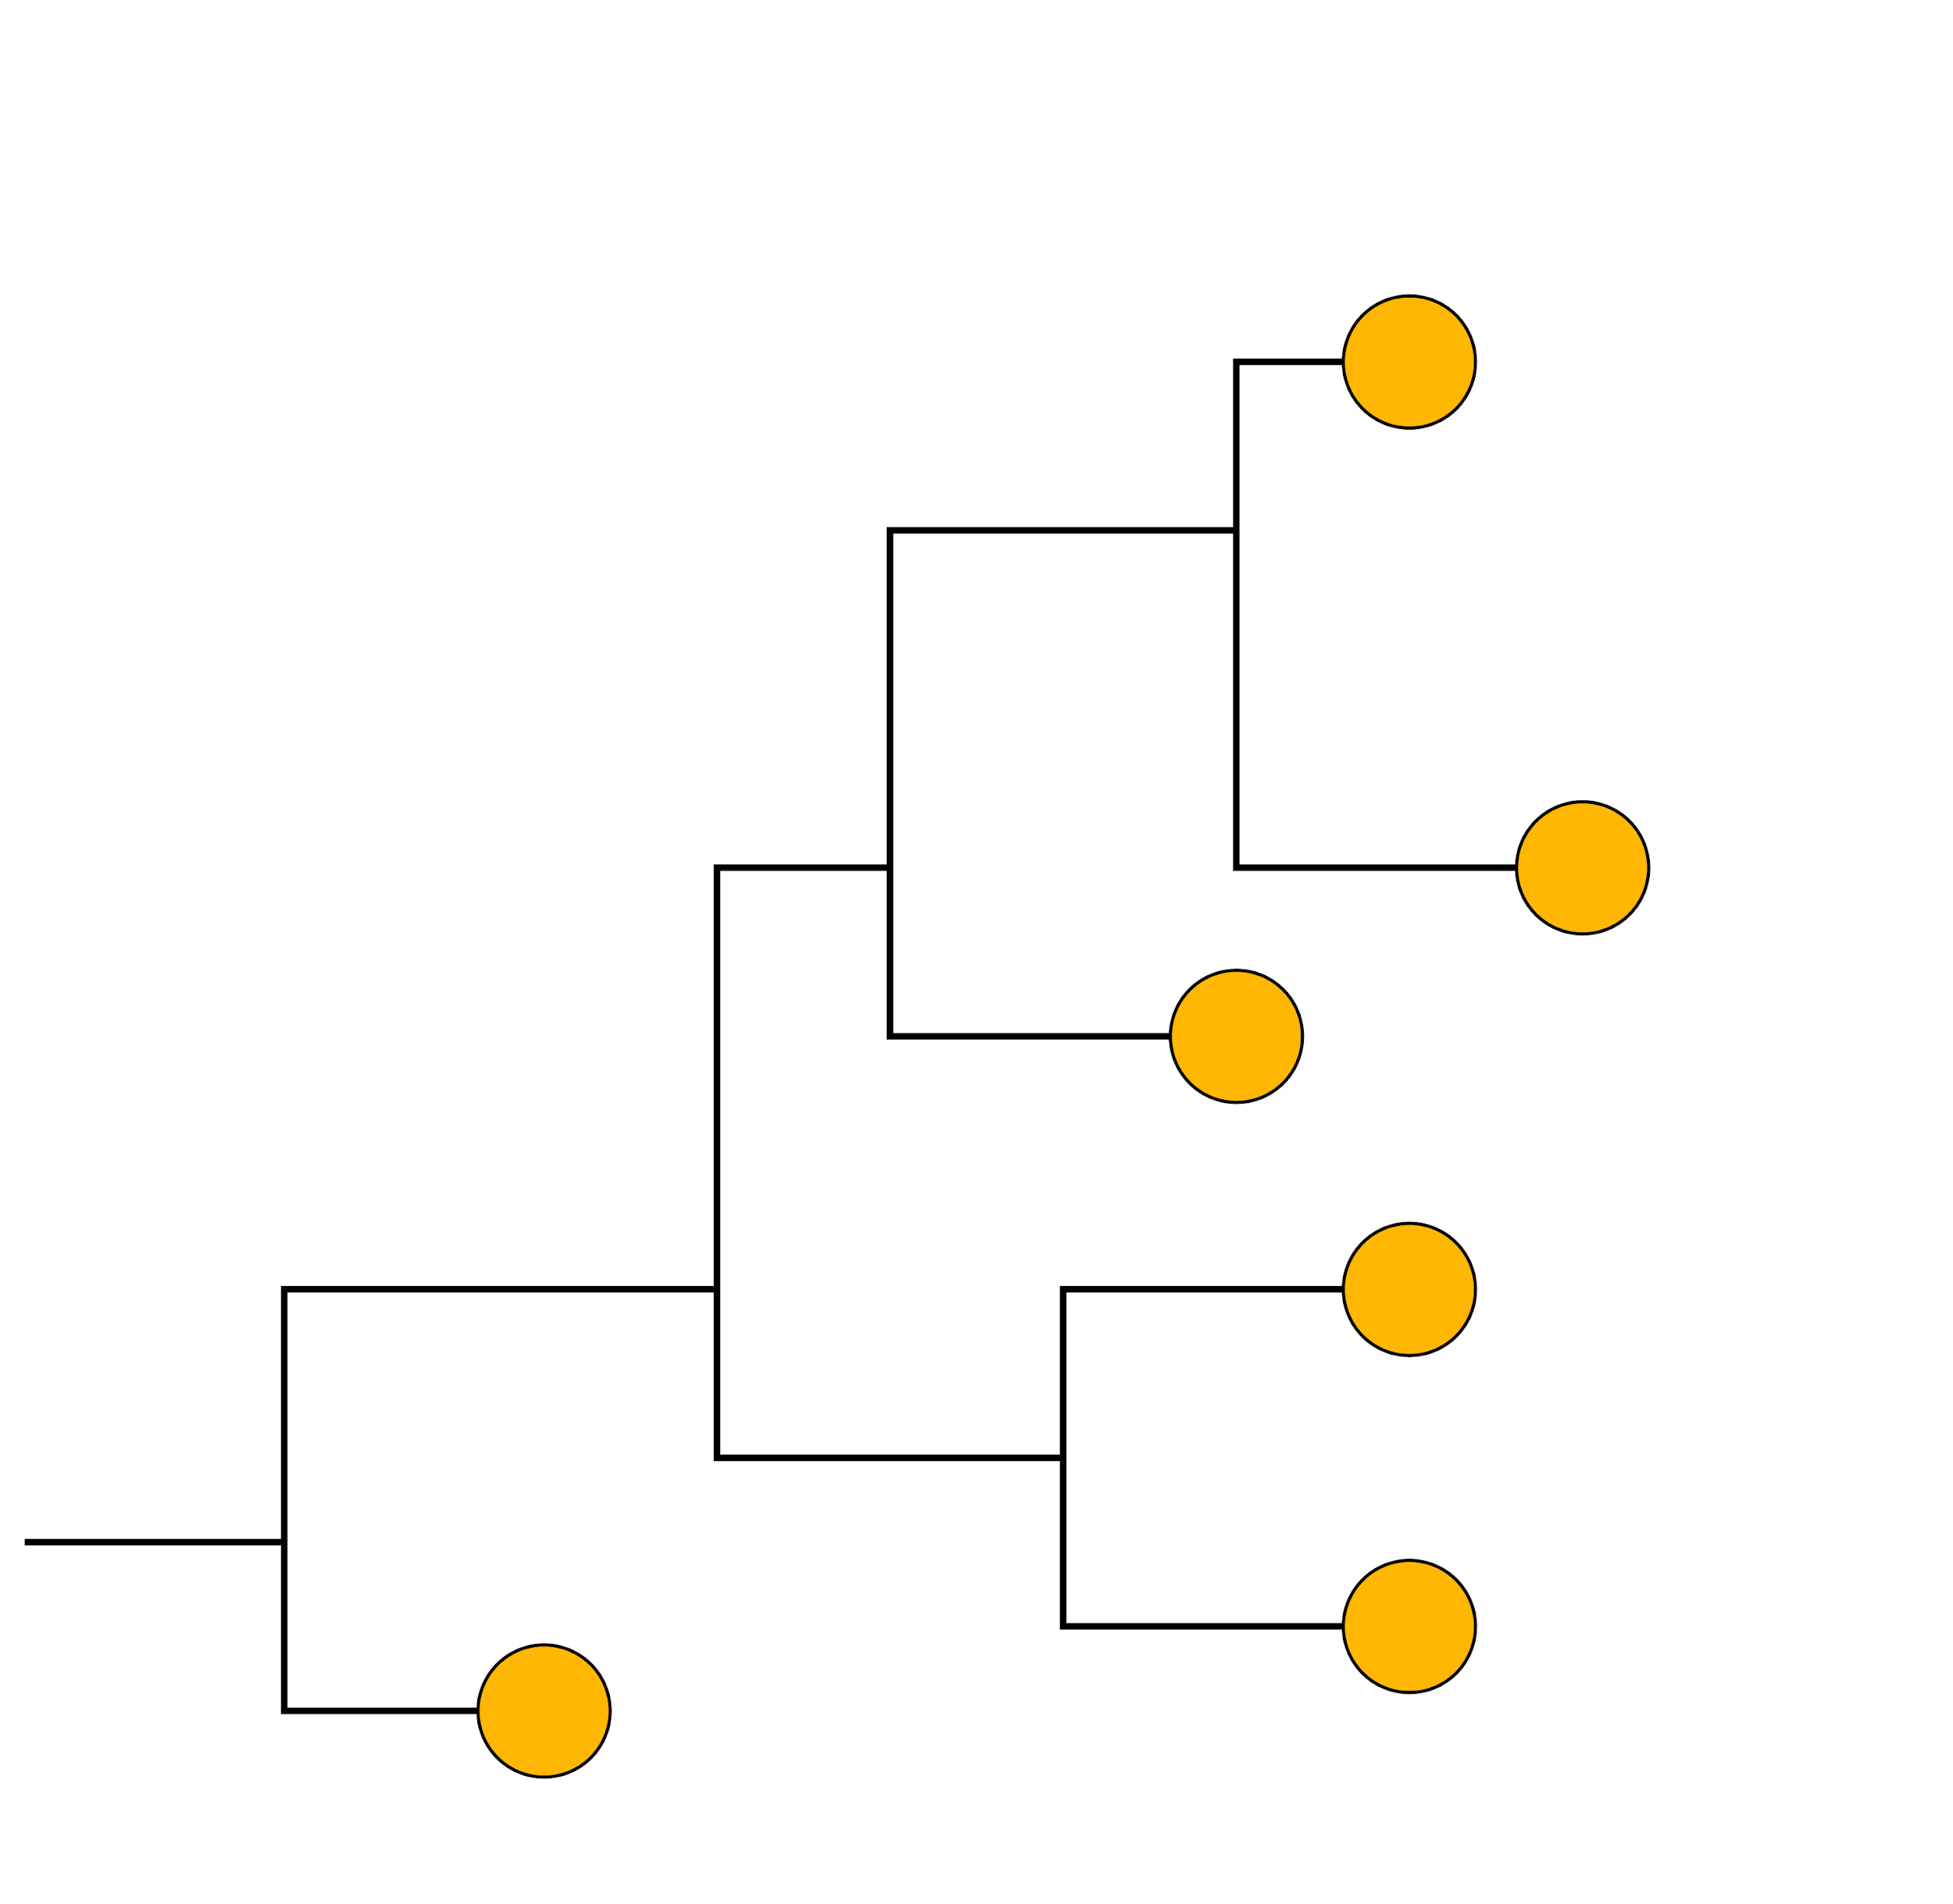
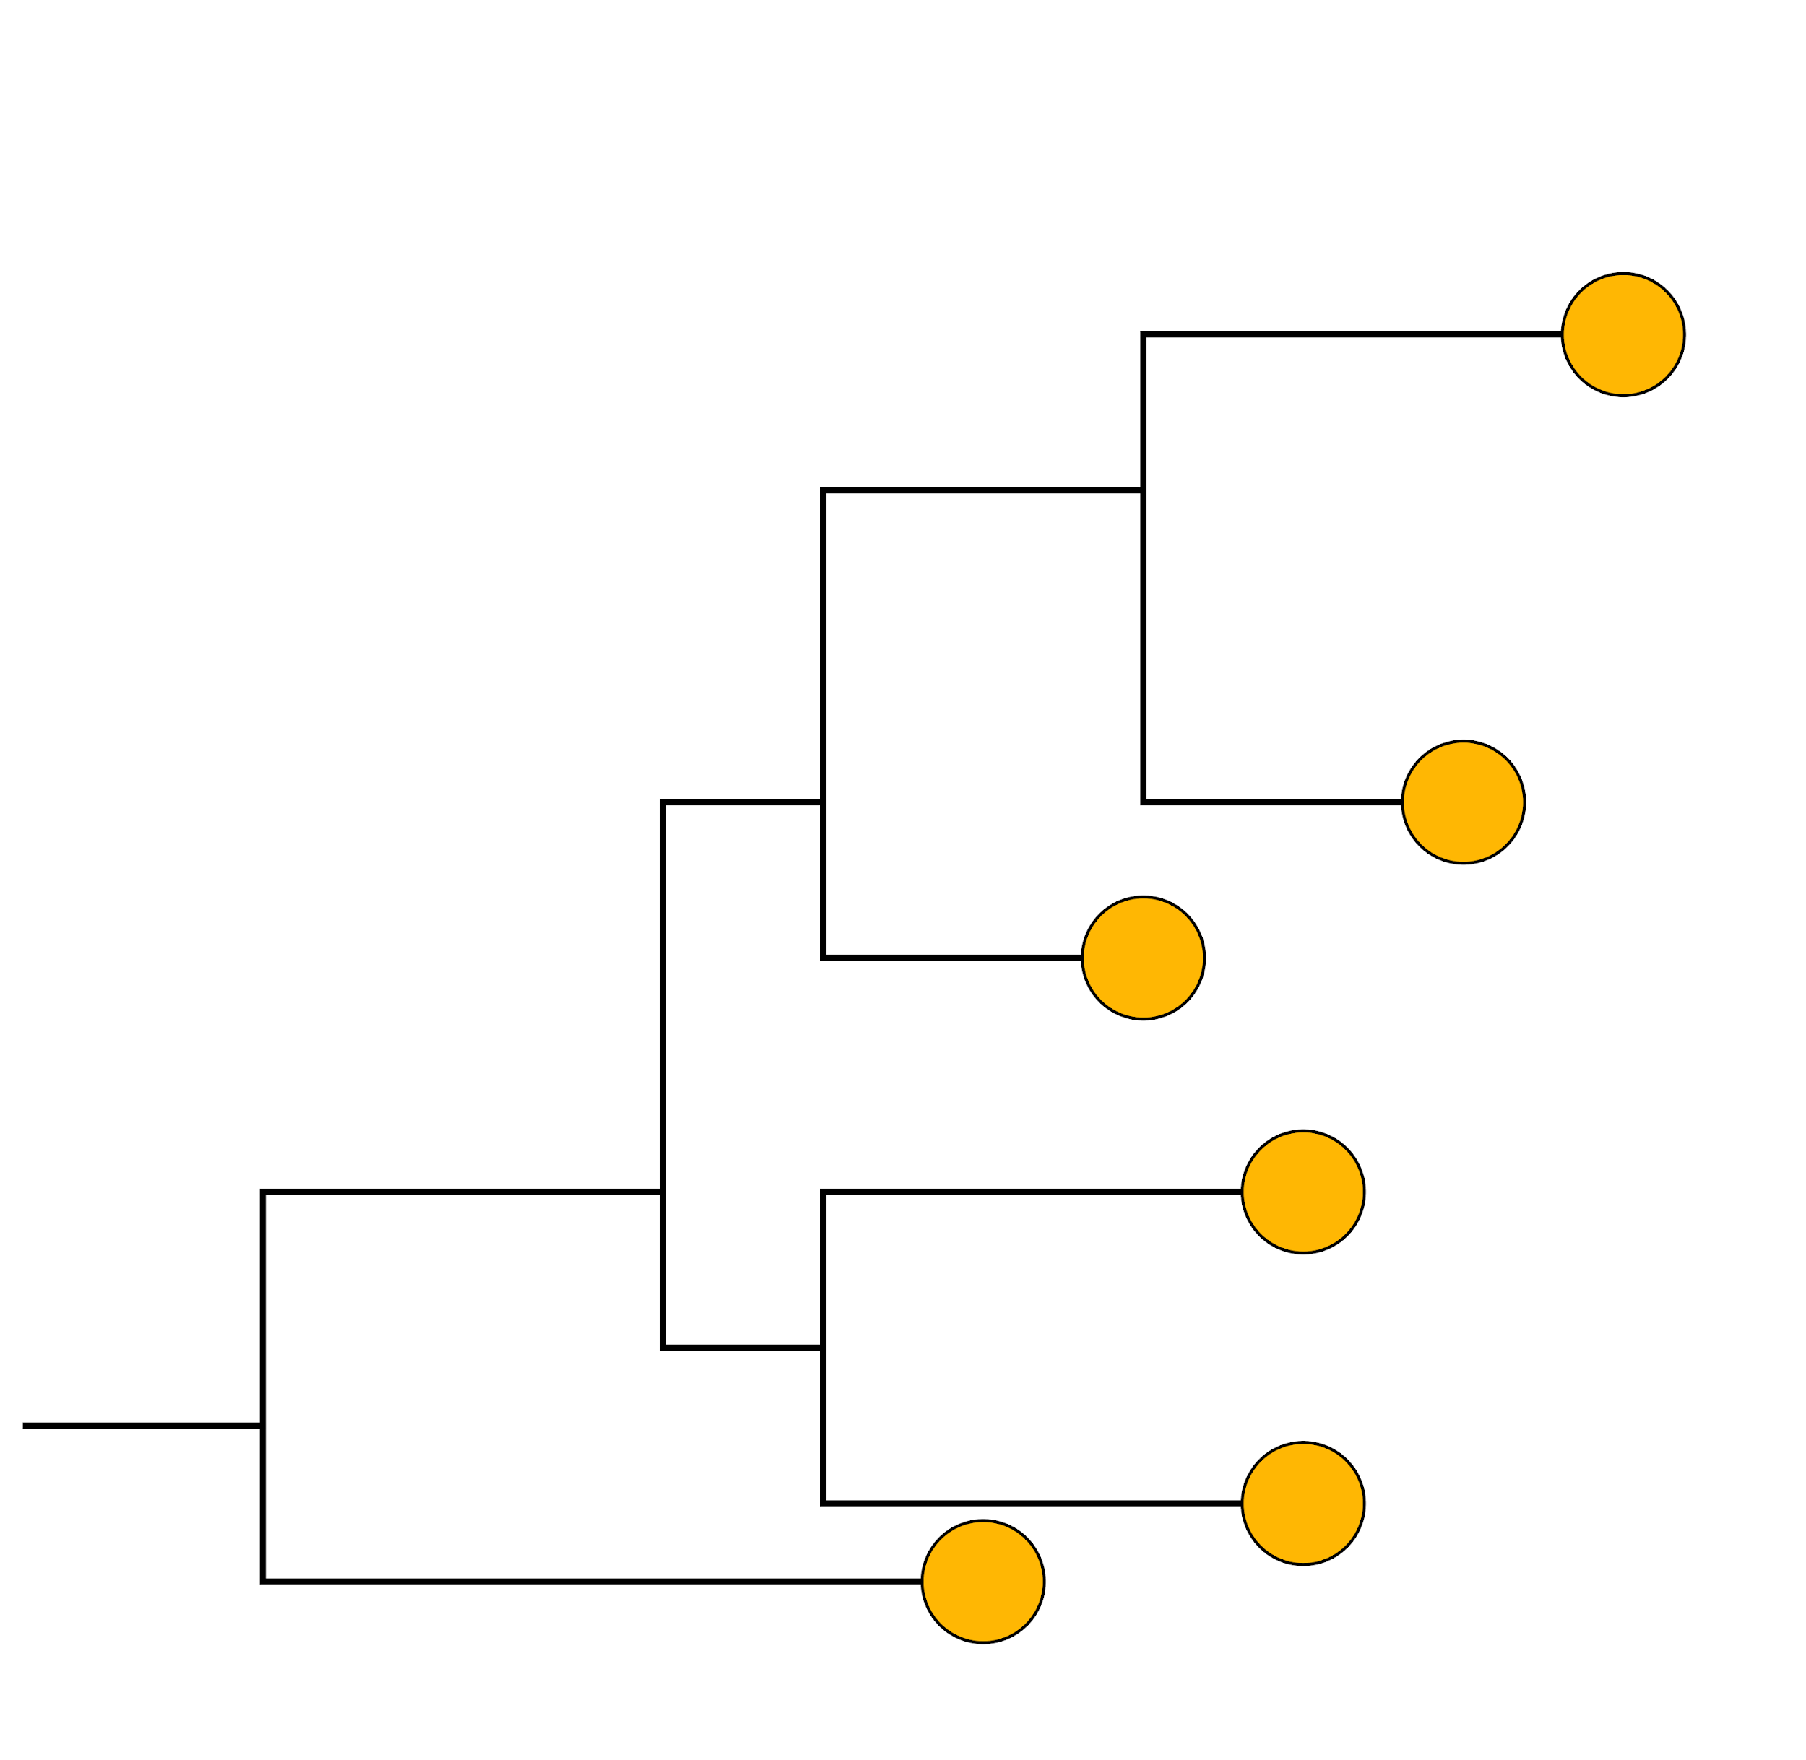

Tree search algorithm to find the best tree
lnL = -1111
lnL = -1344
lnL = -1561

Slide 42
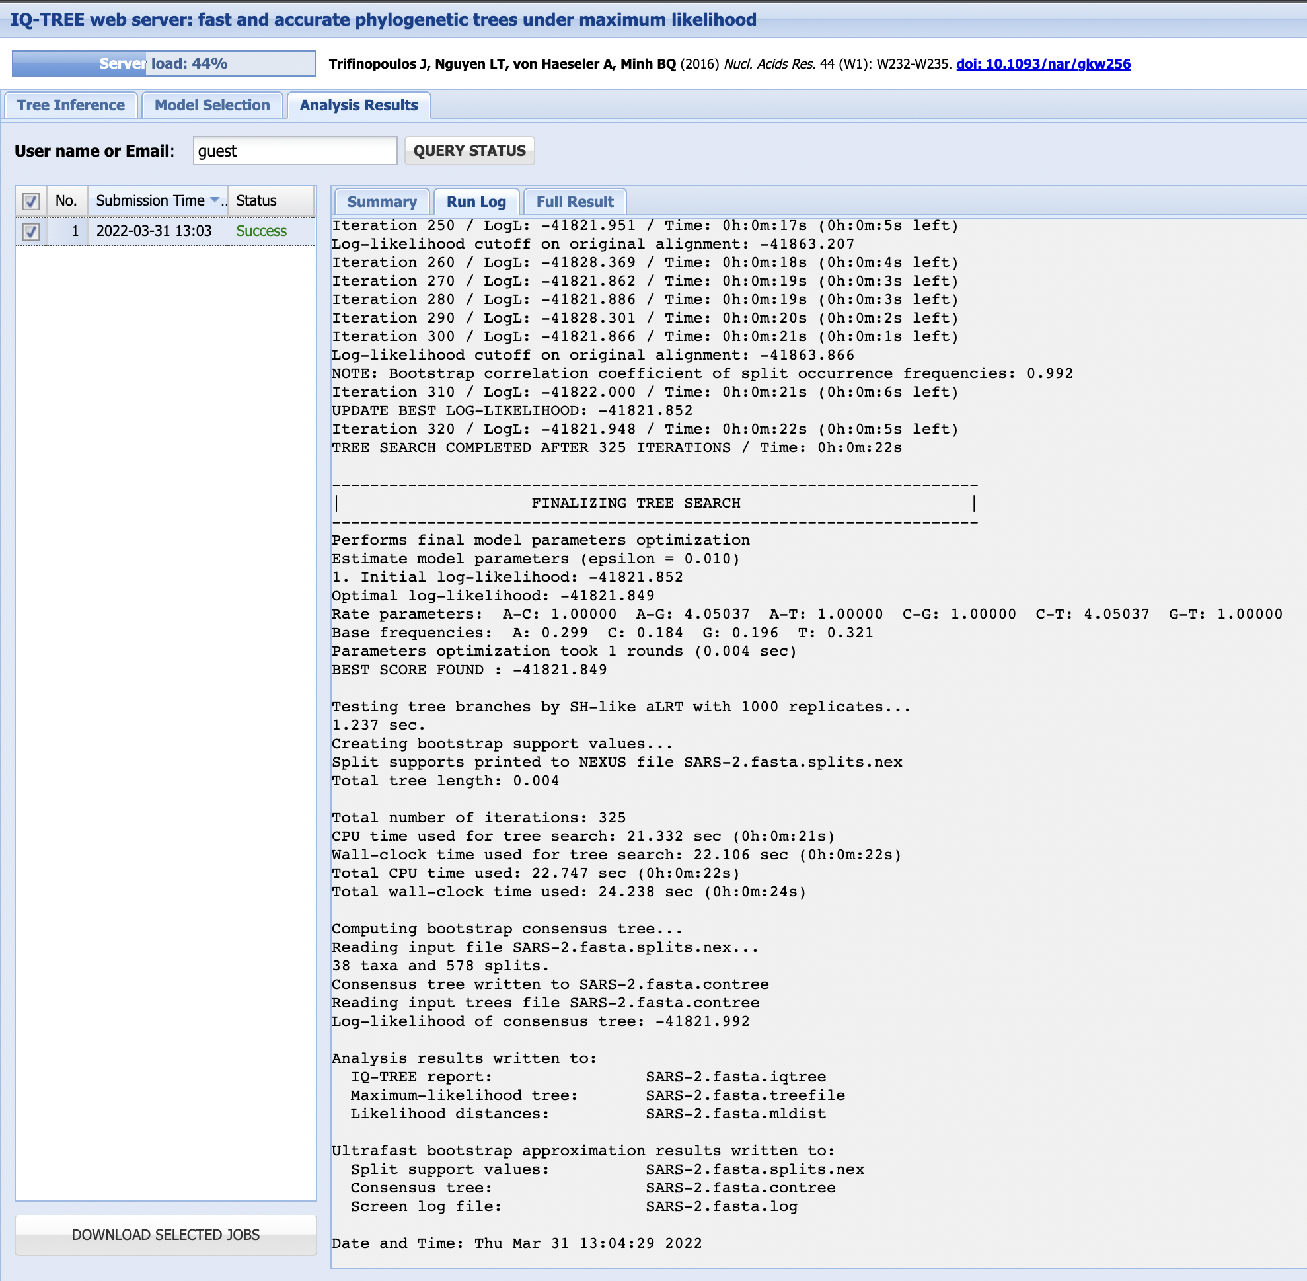

Slide 43
IQ-TREE output files
Suffix | Explanation
.iqtree | The main report file
.log | Logfile for the run
.treefile | Maximum likelihood tree in NEWICK format (can view in Figtree)
.svg | Tree visualisation in SVG format
.pdf | Tree visualisation in PDF format
.contree | Consensus tree with branch supports, with branch lengths optimized on the original alignment (if Ultrafast Bootstrap is used)
.ckp.gz | Checkpoint file

Slide 44
Summary
We can reconstruct phylogenies from multiple sequence alignments using maximum likelihood
IQ-TREE is one option for building maximum likelihood phylogenetic trees
We need to choose the correct substitution model for our dataset
Maximum likelihood methods only generate a single tree, so we need to test its repeatability with bootstrapping

